Slide 1

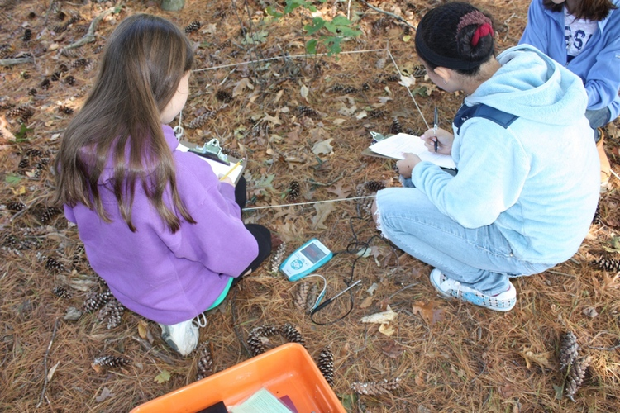
Welcome!
Q&A
Key Things to Know About the WPSF
Grant Application
Q&A Session

Slide 2
Our Mission
The WPSF strives to enhance the educational experience of Wayland’s students, support excellence and inspire innovation in classrooms throughout the school system. The funding of grants focuses on enriching the education of Wayland’s children through creative programs and units of study not covered by the regular school budget.

Slide 3
What Do We Fund?
Any innovative idea that supports our mission
Advances academics, the arts, curriculum-based athletics, student enrichment and/or staff professional development
Improves teaching practices, transforms student learning and enhances the quality of educational programs
Focuses on one or many classrooms, student groups or curriculum areas, as well as school-wide and system-wide initiatives
WPSF grants cannot fund teacher salaries/stipends, substitute teachers, travel, buses, facility rentals, food/refreshments, or hotel expenses.

Slide 4
What Do We Fund?
>$3 million for 700+ ideas
SmartClassrooms – projection systems, document cameras, interactive whiteboards, response systems, iPads, etc.
Thousands of books, audiobooks and e-books for every reading level and interest
Teacher training on reading comprehension strategies, writing across all genres, differentiated math instruction
More personalized math instruction with Symphony Math, FASTT Math, supplementary materials and games
Science labs, data collection devices, robotics and more!
Visit waylandpublicschoolsfoundation.org for more details.

Slide 5
What Do We Fund?
A successful proposal…
Supports WPSF’s mission for innovation and enhanced education
Aligns with educational goals, standards and priorities of the WPS system, schools, departments and/or grade-levels
Articulates the project’s need, benefits and scope
Offers a strong connection to curriculum and/or improved teaching practices
Clearly defines target population and expected outcomes
Illustrates potential for collaboration, replication and future ongoing support by WPS
Provides a complete, detailed list of expenditures
Shows fiscal responsibility – pricing, options for partial or alternative funding

Slide 6

Process & Tips
Plan
Research your ideas and fit with WPSF’s mission
Refine
Get input and buy-in from collaborators or others who may have expertise or may be affected, e.g. teachers, curriculum specialists/department head, administration
Finalize your grant application and include any necessary supporting documents
Submit
Get required signatures – applicant(s), curriculum specialist/department head
Send a signed copy of the application to the Principal by 03/01/2018
Evaluate what’s required, suppliers and costs
Q&A
For all technology, apply with the school’s Instructional Technology Specialist
Determine timing, who needs to be involved, and implementation
Contact us if you do not hear by 03/11/2018 that we have received your application
Provide clarification or additional information to the WPSF Program Committee
Grants will be awarded by mid-April!

Slide 7
Process & Tips
Things to keep in mind…
Get price quotes from and choose suppliers who will accept Purchase Orders (POs)*
If a PO isn’t possible, you may be reimbursed in 4-5 weeks –the Business Office must approve the expense before you make the purchase and must receive an original receipt and a copy of your credit card statement or cancelled check
Reimbursements do not cover sales tax
It may take 6 weeks to process payment for consultants or speakers – signed contract and W-9 are required
  *Most do, but contact Kerri Mulvey to see if PO arrangements are in place with
  online or local suppliers.

Slide 8
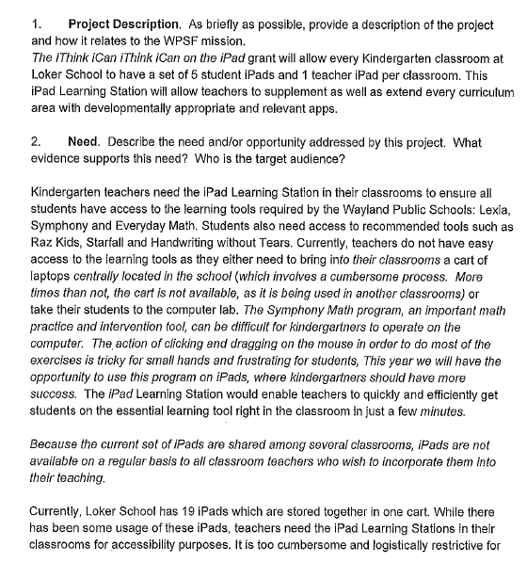
Process & Tips
Sample Application
Tip #1:
Briefly explain your idea and how it enhances learning or improves things.
Tip #2:
Correlate the need to your idea.

Slide 9
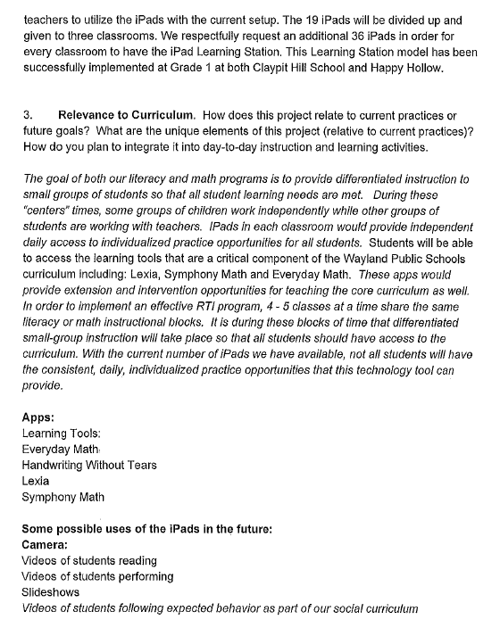
Process & Tips
Sample Application
Tip #3:
Summarize key facts and provide references (past projects, web site links)
Tip #4:
Be specific about how you will incorporate your idea into the curriculum and how it may support district and school goals.

Slide 10
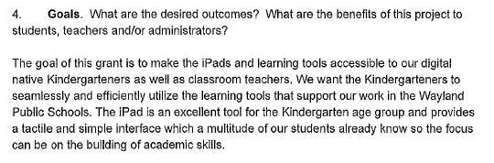
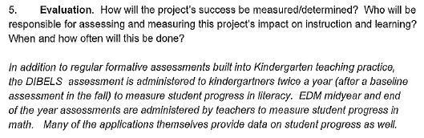
Process & Tips
Sample Application
Tip #5:
Try to set measurable goals – both quantitative and qualitative.
Tip #6:
Describe how you intend to measure progress and outcomes. This info will be useful in your final report to the WPSF.

Slide 11
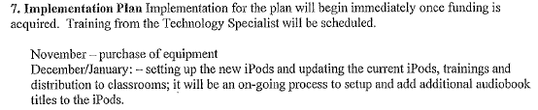
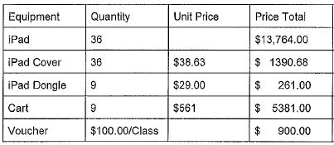
Process & Tips
Sample Application
Tip #7:
The plan should include a timetable of essential project tasks or events in sequential order.
Tip #8:
Provide unit costs in your budget.

Slide 12
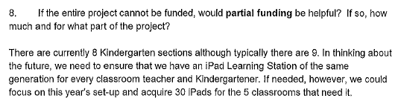
Process & Tips
Sample Application
Tip #9:
You can increase your chances of funding if you logically break down the project into smaller pieces or find other funding sources.

Slide 13
Process & Tips
A Great Resource: Past Grant Award Winners
Elementary
Karyn Saxon
Middle School
Carrie Dirmeikis
Whitney Tandon
High School
Mary Barber
Janet Karman
Tricia O’Reilly
Deane Coady
Maureen Devlin
Mike Moynihan
Anne Johnson
Deborah Dowd
Beth Crozier
Nancy Colbert
Joe Oneschuck
Kevin Delaney
Ed DeHoratius
Janet Armentano
Paul Shiffler
Ellen Jacobs
Tom Longnecker
Rebecca Poulo
Donna Sumner
Beth Ann Monahan
Stephen Murray
Jacob Montweiler
Frank Lenz
Brian Keaney
Kristin Murphy
Alicia Fine
Ken Rideout
… to name a few frequent grant recipients

Slide 14
Questions?
For specific questions about your idea, please contact Julia VanRooyen (juliavanrooyen@gmail.com) or Moira Breen (moira.e.breen@gmail.com)
For general questions or help after you receive a grant, please contact your school liaison:
  Claypit: Miti Koopersmith (irma.koopersmith@gmail.com), Risa Burgess (risa.burgess@gmail.com)
  Happy Hollow: Amy Sullivan (amy_sul@comcast.net)
  Loker: Liza Knapp (lizaknapp1@gmail.com), Jennifer Sheldon (jennifer.sheldon@gmail.com), Daria Greeley (dariaegreeley@gmail.com)
  WMS: Jean Prince (theprincefamily@mac.com), Julie Ellenbogen (julie.ellenbogen@gmail.com)
  WHS: Sheila Brown (sheila.mckenney.brown@gmail.com), Lana Murphy (murphyhq@verizon.net)
For questions about the purchasing process or suppliers who accept Purchase Orders, please contact Kerri Mulvey (kamulvey3@gmail.com) 508-358-3757)
Visit our web site at waylandpublicschoolsfoundation.org

